Slide 1
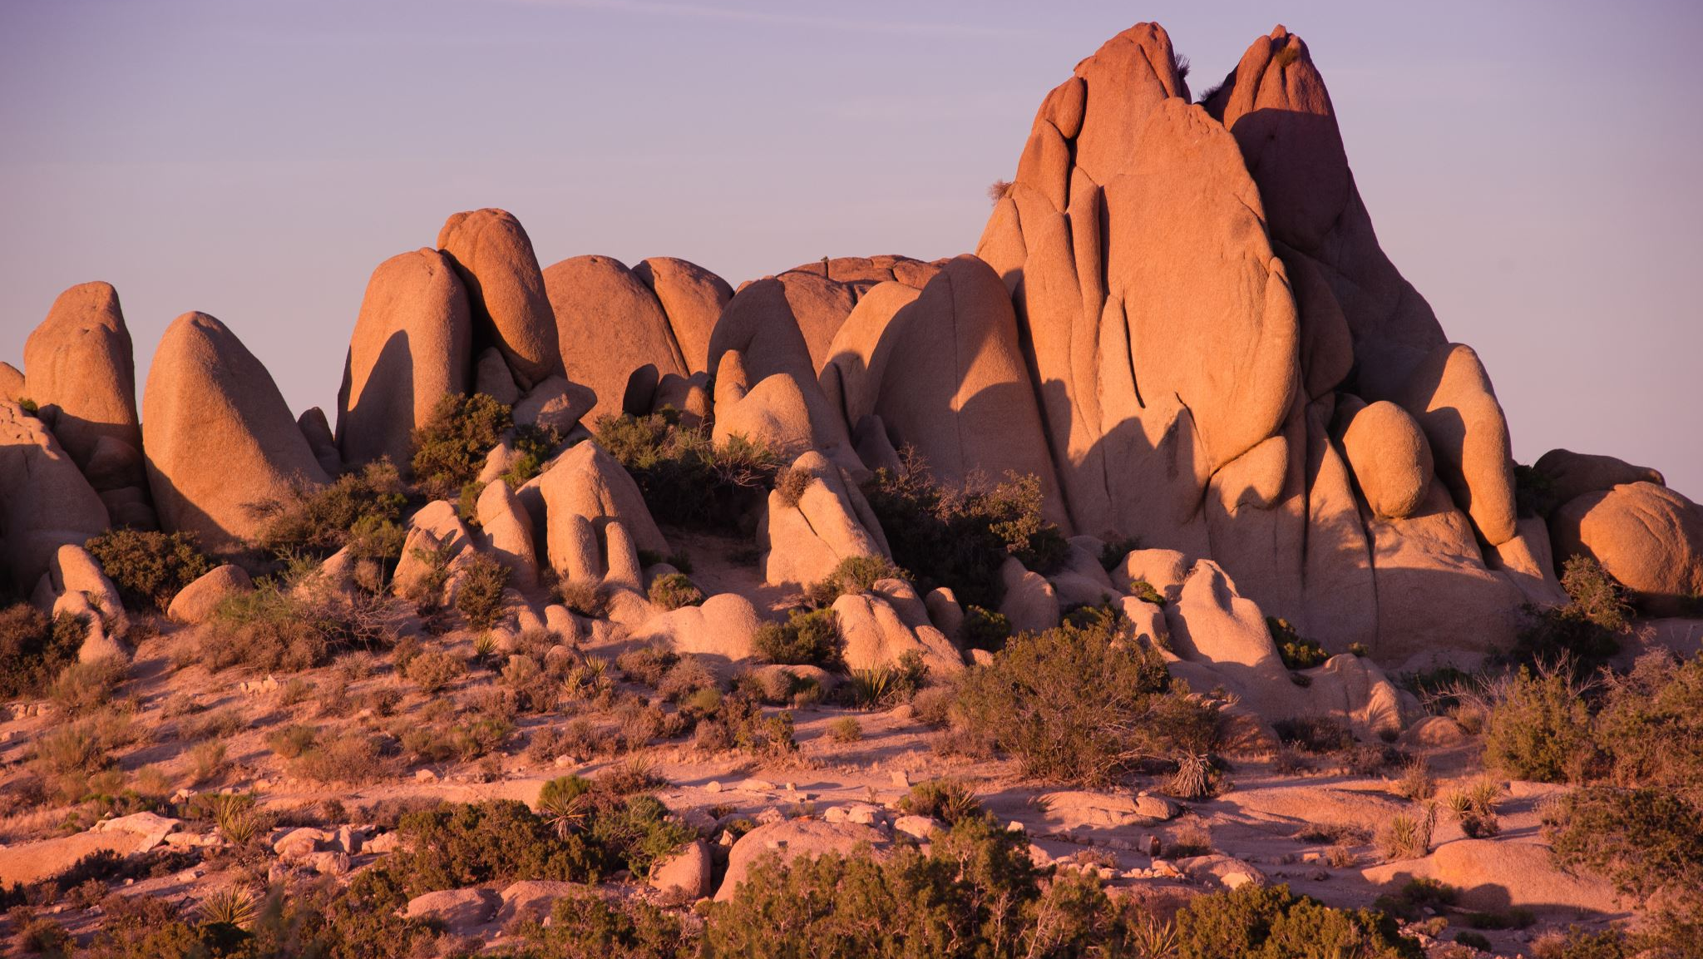
Massive Igneous Rocks
Grade 11

Slide 2
Igneous Landforms
Igneous rock forms when molten rock material cools and solidifies.
Intrusive rocks cool far below the surface where pressure from overlying rocks ensure that the cooling down takes place slowly and crystals form in the rock.
Extrusive rocks cool down above the surface. They cool faster and the crystals forming in them, are smaller.
It is important to remember that igneous rocks do not have strata (layers) like in sedimentary rocks.
They instead form a huge mass that can measure thousands of square kilometres.

Slide 3
Intrusive and Extrusive Rocks

Slide 4
Igneous Landforms
Granite is an example of igneous rock and consists of numerous minerals but has three main components:
Quartz
Mica
Feldspar (this is the cement holding granite together).

Slide 5
Igneous landforms
When rainwater combines with carbon dioxide it forms a weak carbonic acid.
This acid water dissolves feldspar and causes granite to gradually crumble.
Paarl Mountain in the Western Cape is an example, but it is tiny in comparison with the Idaho batholith in the U.S.A.
When igneous rock, like batholith, laccolith and lopolith, form under the surface, they are hidden from view and do not have much impact on surface structures.

Slide 6
Paarl Mountain

Slide 7
Idaho batholith in the U.S.A.

Slide 8
Igneous landforms
Sometimes entire mountains must be moved for these massive structures to become visible.
When batholite is exposed it appears in the form of a huge dome and because of its size it appears bottomless.
A radial drainage pattern (centrifugal) will usually form on batholith
A large flat dome exposed on the surface when the landscape is lowered by erosion is called Ruware.
When they form near the surface, large granite structures can cause overlying layers to buckle or tilt.

Slide 9
Igneous landforms
A laccolith is in the shape of a mushroom with a stem formed bt the volcanic pipe.
A lopolith has a saucer shape due to the way the underlying layers collapsed under the weight of a huge intrusion.
The Bushveld Igneous Complex is a good example of lopolith.

Slide 10
Igneous landforms

Slide 11
Formation of Granite Domes
What is it?
a large rounded dome-shaped structure or hill with bare rock exposed over most of the surface.
Where can it be found in South Africa?
Paarl Mountain

Slide 12
Stages of development

Slide 13
Granite Dome (Paarl Mountain)

Slide 14
Formation of Tors
What is it?
Tors: a rocky pile or outcrop of stacked piles of partially rounded boulders, called core stones, loosely resting on top of one another.
Where can it be found in South Africa?
Valley of Desolation – Graaff- Reinet, Lowveld and Namaqualand.

Slide 15
Stages in development

Slide 16
Valley of Desolation – Graaff- Reinet, Lowveld and Namaqualand.

Slide 17
The formation of Tors
Granite appears to be a solid rock but it has numerous cracks and weaknesses.
As the overlaying rocks erode away, the release of the pressure on the granite forces cracks to develop. These cracks are known as unloading joints.
In humid conditions these cracks allow water to penetrate deep into the rock, where mechanical weathering can occur.
This will gradually widen the joints.
The remaining rocks are rounded by weathering and form core rocks.

Slide 18
The formation of Tors
As the overlying layers are eroded away, the loose material in the joints are washed away.
The result is that large mounds of rounded core stones are found. They look like they have deliberately been piled up in a heap.
These structures are common in the Northern Cape and are called Tors.
This formation of Tors is in accordance with the opinion of D.L. Linton. Some scientists disagree with him. They say Tors can also be formed in non-humid areas. They say this might also happen in freeze-thaw processes that causes exfoliation of rocks. This is where the water in cracks freeze and thaw.

Slide 19
The formation of Tors
When water freezes, it expands and enlarges the cracks and eventually splitting the toughest rocks.
Exfoliation describes the process where layers of granite flake of like the skin of an onion and is also called onionskin weathering.
Most scientists now agree that tors can be formed either way. Or through a combination of both ways.

