Slide 1
Slopes
Unit 4

Slide 2
What does South Africa’s topography look like?
South Africa has an average altitude of about 1 200 metres above sea level, and nearly half of the surface is at a higher elevation. Parts of Johannesburg are more than 1 800 metres above sea level.
The land rises steadily from west to east to the Drakensberg Mountains, part of the Great Escarpment, to a height of 3 408 metres above sea level.

Slide 3
What does South Africa’s topography look like?
The country comprises five main physiographic regions:
the south western Cape Fold Belt mountains
the coastal plain, which extends from the Namibian border all along the coast to Mozambique
a vast saucer-shaped interior plateau
the Great Karoo basin from 1 400−1 600 metres above sea level and the Kalahari basin bordering on Namibia and Botswana
the central Highveld situated at 1 600−1 700 metres above sea level.

Slide 4
The five main physiographic regions of South Africa

Slide 5
Types of slopes
What is a slope?
Slopes can be described as curved, inclined surfaces that form the boundaries of landforms like mountains, plateaus, hills.

Slide 6
What do the different types of slopes look like?
The plan dimensions of slopes are illustrated by distinct contour patterns. Slopes form spurs, valleys, cirques, hills and ridges. These are all combinations of slopes arranged in particular patterns. Figure 58 shows the different types of slopes.

Slide 7
Slope elements and characteristics
There are four slope elements. From the top to the bottom, they are:
The crest, is at the top of the hill and usually has a convex shape. The main geomorphological processes acting on it are weathering and soil creep.
The free face, scarp or cliff, is the almost vertical slope. It is too steep for any loose material to collect on it. The main geomorphological process acting on it is mass movement.

Slide 8
Slope elements and characteristics
The talus, debris or scree slope, is the smooth slope at the foot of the free face. Deposition is the main geomorphological process on the talus slope.
The pediment is the plain at the base of a slope. It may be slightly concave in shape. Between the talus and the pediment slope, there is sometimes a distinct break in the profile, called the knickpoint. Erosion by running water is the main geomorphological process.

Slide 9
The four element slope

Slide 10
Slope elements and characteristics
All four slope elements are not present on all slopes. One or more of them may be repeated, as in areas where there are alternating layers of hard and soft rock.

Slide 11
How do slopes develop over time?
There are various different theories to explain the origin of slopes. Here we will discuss the concept of parallel slope retreat.

Slide 12
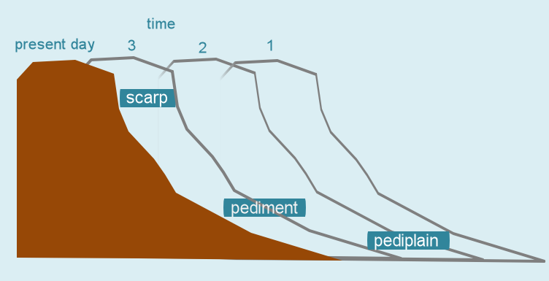
What is parallel slope retreat?
The slope angle and lengths remain constant as the slope retreats parallel to itself for each part of the slope. The pediment increases in length over time.

